Slide 1
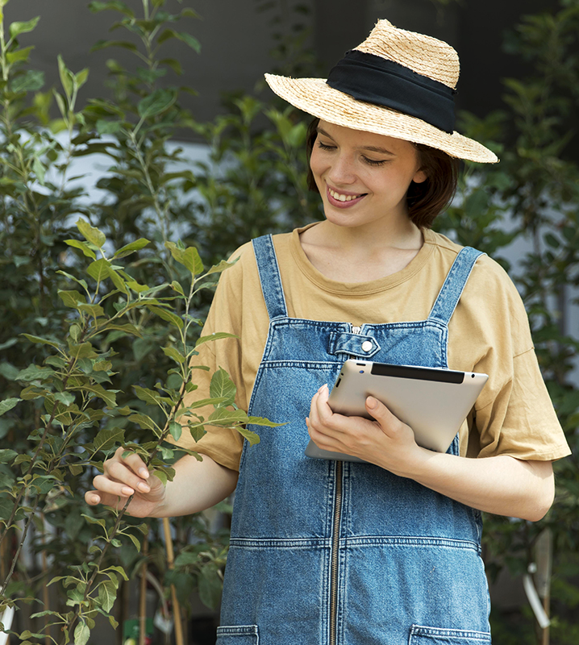
AgriEasy
HARVESTING THE FUTURE OF AGRICULTURE
Team :
Bisuraj Sharma(20BCE2923)
Sumit Kumar Mandal(20BCE2885)
Ujjwal Tiwari(20BCE0415)
Bijan Shrestha(20BCE2904)
Anish Shrestha(20BCE2893)

Slide 2
TABLE OF CONTENTS
INTRODUCTION
PROBLEM STATEMENT
01
02
03
LITERATURE SURVEY
DATASET USED
04
01
02
This Slide Give a brief introduction about the project
This slide describes the problem statement we are working on
03
04
This slide describes about dataset being used in our project
This slide summarizes the existing work
METHODOLOGY
PERFORMANCE MEASURE
04
05
This slide Describe the methodology used
This slide contains the objective and subjective measures

Slide 3
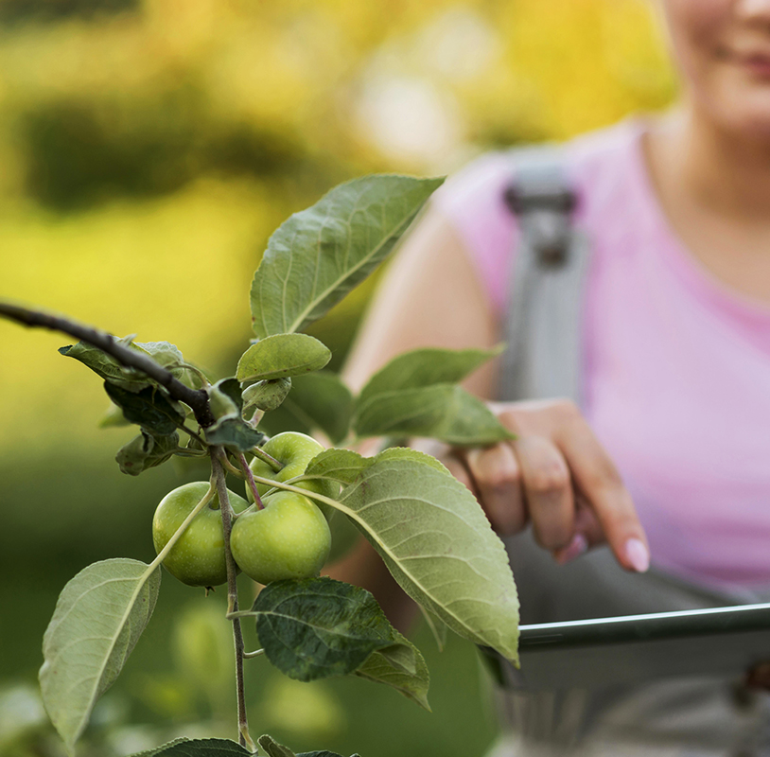
INTRODUCTION
For farmers, agriculture is essential as it is the main source of their income, giving them the ability to grow crops and raise animals for food and other items, which they can then sell to make a living.
The major cause of agricultural loss is frequently due to pests and illnesses. Plant diseases may have a big impact on agriculture, reducing overall on production or even causing total crop failure, which is expensive for farmers.
Early disease detection helps to adopt effective control measures, such as the use of pesticides or other control measures, which can help to lessen the disease's detrimental effects on crop production. Early disease detection also helps to reduce crop losses and prevent the disease from spreading to nearby plants.

Slide 4
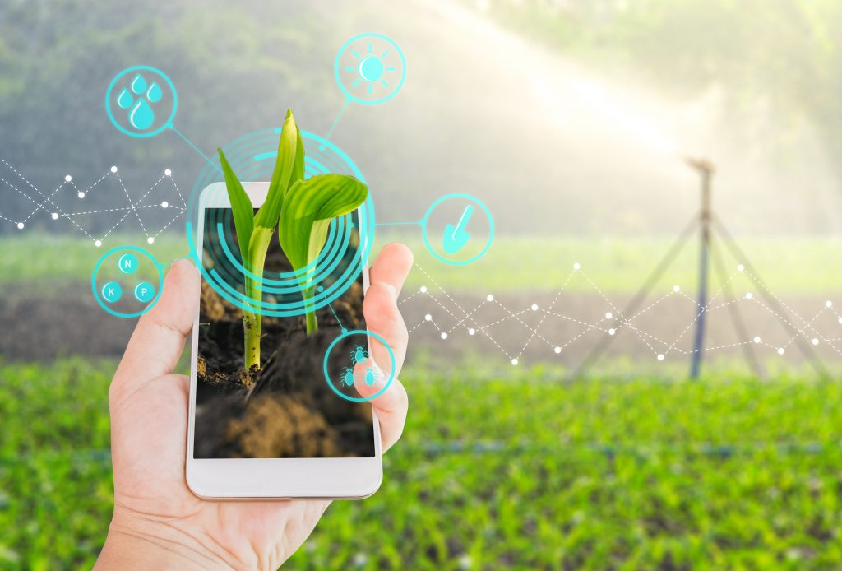
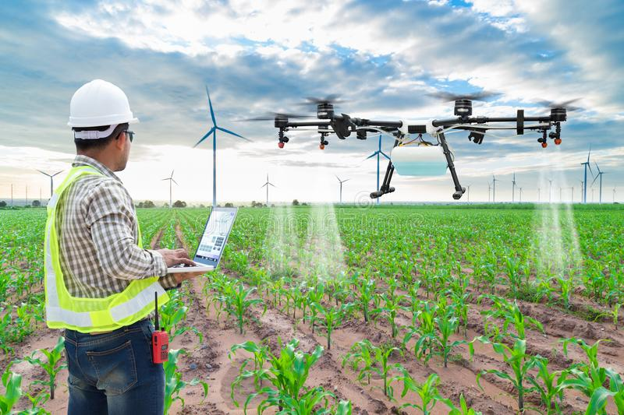
It can be quite difficult to manually identify the appropriate characteristics for differentiating between various forms of crop illnesses since there are so many distinct types of plant diseases.
A plant disease detection is one of the major aspects of this model. It uses image recognition, Machine Learning classification model, CNN model to identify and analyze common plant diseases, enabling farmers to address to the possible problems immediately.
The term "image recognition technology" describes a computer or other machine's capacity to recognize and comprehend the contents of an image. This is achieved through the use of machine learning algorithms, which can be trained to recognize patterns and objects within images.
A deep learning model called a CNN (Convolutional Neural Network) image recognition model is ideally suited for picture categorization and object recognition applications. Utilizing a technique known as convolution, CNNs train their models to recognize patterns and features in pictures by examining discrete areas (or "windows") of the image at a time.

Slide 5
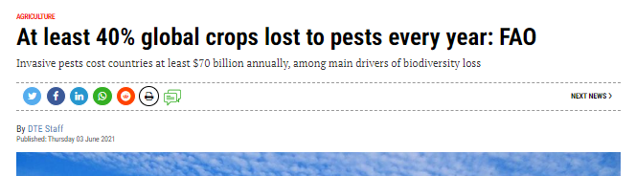
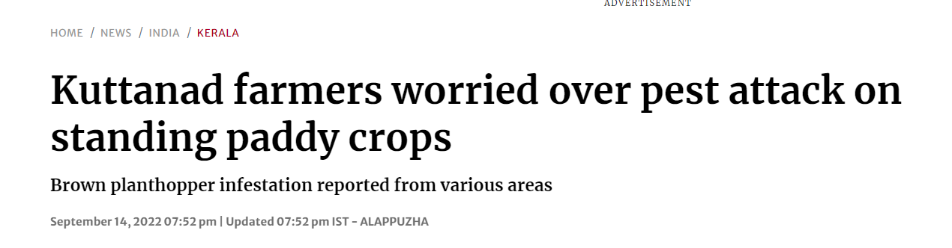

PROBLEM STATEMENT
A recent report estimates that invasive pests cost countries at least $70 billion annually and that as much as 40% of the world's agricultural crops are lost to pests each year.
Improved monitoring and surveillance systems as well as more eco-friendly and comprehensive pest management techniques are necessary.
Objective : Develop a machine learning model that detects disease in plants from the plant leaves datasets to mitigate the impact of pests on agricultural crops, its control and detection.
Input : Image input to detect the disease on crops, various API calls to train the datasets.
Output: Detection of plant disease

Slide 6
LITERATURE REVIEW
RefNo. | Methodology | Datasets | Performance Measures | Limitation
[5] | Fine-tuned CNN, Stochastic Gradient Descent (SGD), VGG16. | The Plant Pathology Dataset 2020 | Recall- 0.85, Accuracy- 0.85, F1-Score- 0.85, Average Score 735, Accuracy = (85%) | A software application is needed, The model could not generalize to other forms of plant diseases.
[6] | 5 Layers CNN, DCNNs, AlexNet and conventional classifiers. | PlantVillage Dataset, and ForestryImages Dataset | Precision- 92.18%, Accuracy- 93.4% and 92.2% | Limited Dataset, Not able to generalize to different types leaf symptoms or diseases.
[7] | Efficient De deep learning model, Backbone Network, BiFPN Network, and Class/ Box Prediction Network | PlantVillage Dataset | Precision- 88.13%, Recall- 94.06% and F1-score is 90.99%, Accuracy- 74.10% | The crop species which are trained are less.

Slide 7
LITERATURE SURVEY
[8] | YOLOv3, Simple Classifier, VGGNet, Transfer Learning with ResNet. | PlantVillage Dataset | Accuracy- 96% | It does not provide specific details about the type of model used for leaf classification or the dataset it was trained on.
[9] | Faster R-CNN. (RPN), (ROI) pooling and classifier. | Citrusleave prepared Dataset | F1-score -(90, 97.9, 93.0), Precision- (93.8, 99.0, 91.0), Recall- (87, 95.8, 94.6), Accuracy- (86.18, 97.2, 94.64) for blackspot, Canker, Huanglogbing, respectively. | Improvement on robustness , reduce the standard deviation.
[10] | convolutional neural network using TensorFlow for deep learning. | The Kaggle Fruits 360 Dataset | Accuracy: 93.3% The SVM scored 89.1%. | Not many diseases are detected in this system.
[11] | Two-channel CNN: VGG and ResNet model | Leafdisease Dataset | VGG validation accuracy: 93.33%, loss: 0.2385, ResNet validation accuracy: 97.75%, loss: 0.1276, Final validation accuracy: 98.33%, loss: 0.07628 | Good RGB pixel camera is needed, updating in leaf disease over a period need to be done.

Slide 8
LITERATURE SURVEY
[12] | Deep CNN. | PlantVillage Dataset | Accuracy: 98.18% Training Accuracy: 0.9836 Validation Accuracy: 0.9806 Precision: 0.9831 Recall: 0.9816 F1-Score: 0.9816 | Limited to leaves dataset only, fewer categories of just 38 by species.
[13] | CNN model with the integration of computer vision (CV). | PlantVillage Dataset | Average final accuracy - 93.8% Precision - 0.991, Recall - 0.959, F-measure- 0.975. | Available Databases and Size Issue, Issues with Available Feature Extraction Methods, Difficulties in Classification Module, limitations of available systems.
[14] | CNN and SVM model. | Rice leaf disease Dataset | Average accuracy correct recognition rate 96.8% | Small Sample size, Lack of diversity in images, only rely on color features which lead to less accurate

Slide 9
DATASET USED
Here, we have used Plant Village dataset that is publicly available.
Attribute | Value
Number of classes | 38 (37 diseased, 1 healthy)
Total number of images | 54,306
Minimum image size | 256x256 pixels
Maximum image size | 1,280x960 pixels
Image format | JPG
Source | Publicly available
DATSETS SOURCE:
https://github.com/spMohanty/PlantVillage-Dataset/tree/master/raw/color

Slide 10
DATASET USED
Class Name | Number of Samples | Challenges
Apple | 1447 | Fire blight, powdery mildew, apple scab
Bell Pepper | 1754 | Bacterial spot, anthracnose, Phytophthora blight
Blueberry | 151 | Mummy berry, stem blight, rust
Cherry | 790 | Cherry leaf spot, brown rot, powdery mildew
Corn | 2267 | Corn smut, common rust, northern corn leaf blight
Grape | 2776 | Black rot, powdery mildew, downy mildew

Slide 11
DATASET USED
Orange | 550 | Citrus greening disease, citrus canker, black spot
Other citrus | 256 | Citrus blackfly, citrus rust mite, root rot
Peach | 2746 | Peach leaf curl, bacterial spot, brown rot
Pepper | 223 | Bacterial leaf spot, blossom end rot, bacterial canker
Potato | 2566 | Late blight, early blight, common scab
Raspberry | 216 | Raspberry leaf curl, cane blight, powdery mildew
Soybean | 509 | Soybean rust, brown stem rot, sudden death syndrome

Slide 12
DATASET USED
Spinach | 203 | Downy mildew, white rust, leaf miner
Squash | 814 | Powdery mildew, downy mildew, bacterial wilt
Strawberry | 1463 | Powdery mildew, gray mold, verticillium wilt
Tomato | 1591 | Late blight, early blight, septoria leaf spot
Tomato (leaf) | 138 | Yellow leaf curl virus, bacterial speck, bacterial spot

Slide 13
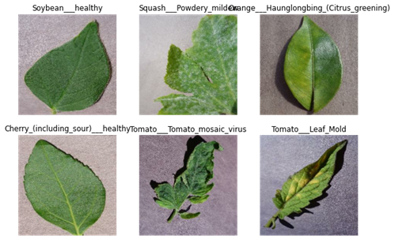
DATASET USED
Sample Images:

Slide 14
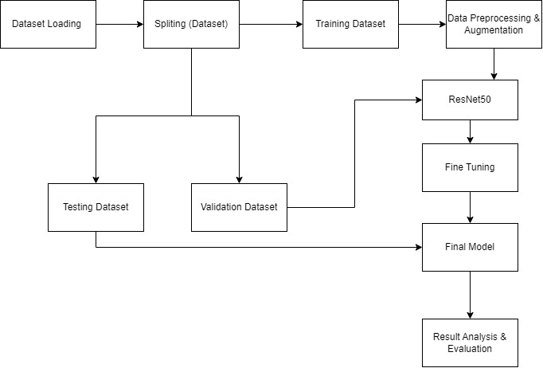
Proposed Methodology

Slide 15
Proposed Methodology
Our study focused on the application of transfer learning in plant disease detection using a pre-trained model adjusted for a similar problem. Specifically, our proposed methodology utilized ResNet50 as a base architecture, which was fine-tuned to classify healthy and diseased plants after pre-processing and augmenting the Plant Village dataset.

Slide 16
Proposed Methodology
Dataset
We are using the “PlantVillage dataset”,[15] which is a publicly available dataset containing images of diseased and healthy plant leaves. The dataset includes images of 38 different plant species, each with multiple categories of disease, as well as images of healthy leaves.
Image Pre-Processing
Image Pre-Processing enhances the picture data required for image categorization. In the Pre-Processing processes, we have scaled down all the photos' resolutions to 256*256 pixels. Then data rescaling can normalize the pixel values of images from the range [0, 255] to [0, 1], making it easier for the model to learn and reducing the impact of outliers.
Data Augmentation
We first define a set of data augmentation parameters and specify a range of random transformations to apply to the input images, including rotations, translations, shears, zooms, and flips. We also specify the fill mode to use when creating new pixels to fill in any empty space that may be created by the transformations.

Slide 17
Continue...
Data Splitting
The data is initially divided into three parts: training, validation, and testing, with a percentage ratio of 80%, 10%, and 10%, respectively.
The training set comprises 34,727 samples, which is 80% of the data.
The validation set is 8,702 samples, which is 10% of the data.
The testing set is 10,876 samples, which is also 10% of the data.
The testing set is used for model evaluation and prediction.

Slide 18
THANK
YOU

